Slide 1
CIRCUIT THEORY LAPLACE TRANSFORM
Declaration : The content of the presentation has been created for academic use / non-commercial use with fair dealing.

Slide 2
SYED HASAN SAEED
URL
http://shasansaeed.yolasite.com/
http://hasansaeed872726549.wordpress.com/
YouTube channel:
https://www.youtube.com/@s.h.tutorials

Slide 3
REFERENCE BOOKS
Introductory Circuit Analysis, Robert L. Boylested, Pearson Education, Prentice Hall.
Networks And Systems, Ashfaq Husain, Khanna Book Publishing Co (P) Ltd. Delhi.
Networks And Systems, A Sudhakar, Shyammohan S Palli, Tata McGraw Hill, New Delhi.
Network Analysis, M.E. Van Valkenburg, PHI Learning Private limited, New Delhi.
Circuit Analysis Principle and Applications, Allan H. Robbins &Wilhelm C. Miller, DELMAR CENGAGE Learning, Indian Reprint.

Slide 4
LAPLACE TRANSFORM
DEFINITION: let f(t) be defined in the interval 0 ≤ t ≤ ∞ , one sided Laplace transform of f (t) is obtained by multiplying f (t) by e^{-st} and integrating the product between the limit 0 to ∞ .
f (t) is a continuous function for t ≥ 0. Laplace transform is a function of independent variable ‘s’ corresponding to complex variable in the exponent of e^{-st}
The complex variable ‘s’ is , in general, of the form form ,
s = σ + jꞶ, Where σ is the real part and Ꞷ is the imaginary axis.
ℒ

Slide 5
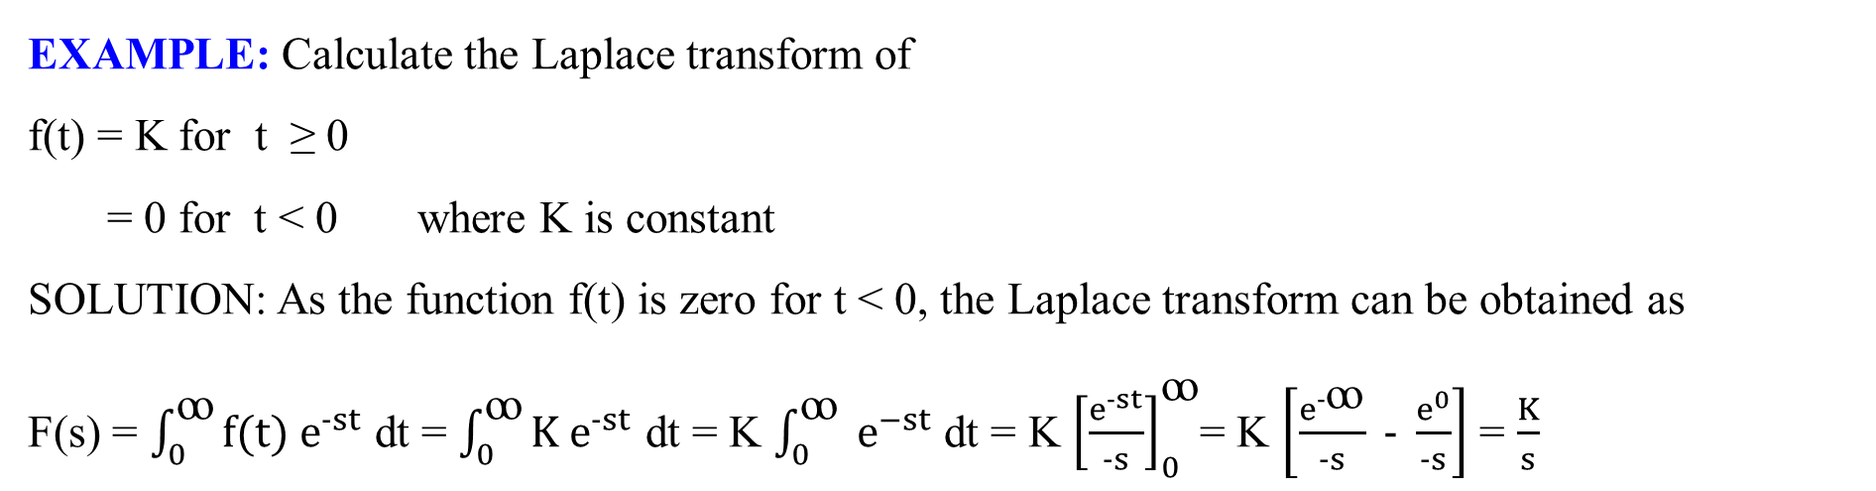
LAPLACE TRANSFORM
Laplace transform changes the domain f (t) to the frequency function F (s).
Similarly, inverse Laplace transformation converts frequency domain function F (s) to the domain function f (t) .
ℒ ⁻¹ [ F (s)] = f (t) =
EXAMPLE: Calculate the Laplace transform of
f(t) = K for t ≥ 0
= 0 for t < 0 where K is constant
SOLUTION: As the function f(t) is zero for t < 0, the Laplace transform can be obtained as
F(s) = $\int_{0}^{ꝏ}{{f(t) e}^{−st}}$ dt = $\int_{0}^{ꝏ}{K e^{−st}}$ dt = K $\int_{0}^{ꝏ}{ e^{−st}}$ dt = K ${\left[\frac{e^{−st}}{−s}\right]}_{0}^{ꝏ}$= K $\left[\frac{e^{−ꝏ}}{−s} − \frac{e^{0}}{−s}\right]$ = $\frac{K}{s}$

Slide 6
LAPLACE TRANSFORM
1. ℒ

Slide 7
LAPLACE TRANSFORM
2. ℒ
SOME IMPORTANT RELATION:

Slide 8
LAPLACE TRANSFORM
ℒ
ℒ
ℒ
ℒ

Slide 9
LAPLACE TRANSFORM
Damped sine and cosine functions:
ℒ
ℒ

Slide 10
LAPLACE TRANSFORM
Similarly,
ℒ
ℒ
ℒ

Slide 11
LAPLACE TRANSFORM
ℒ
ℒ
ℒ

Slide 12
LAPLACE TRANSFORM
PROPERTIES OF LAPLACE TRANSFORMS:
The Laplace transform of a sum ( or difference) of time function is the sum (or difference) of the Laplace transform the individual time function.
ℒ [ f₁(t) + f₂(t) +………+f_{n}(t) ] = F₁(s) + F₂(s) + ……..+ F_{n}(s)
2. The Laplace transform of a product of a constant and a time function is equal to the product of the constant and Laplace transform of the time function.
ℒ [ a f(t)] = a ℒ f(t) = a F (s)

Slide 13
LAPLACE TRANSFORM
Linearity theorem:
If F1(s) and F2(s) are the Laplace transform of f1(t) and f2(t) and a1, a2 are arbitrary constant then
ℒ [ a₁f₁(t) + a₂f₂(t) ] = a₁ F₁(s) + a₂F₂(s)
ℒ [f₁(t) .f₂(t) ] ≠ F₁(s) . F₂(s)
3. Laplace transform of a Derivative of a function
Where f(0₋) is the value of f(t) at t = 0
d f(t)
dt
ℒ
= f ′ (t) = sF(s) –f(0₋)

Slide 14
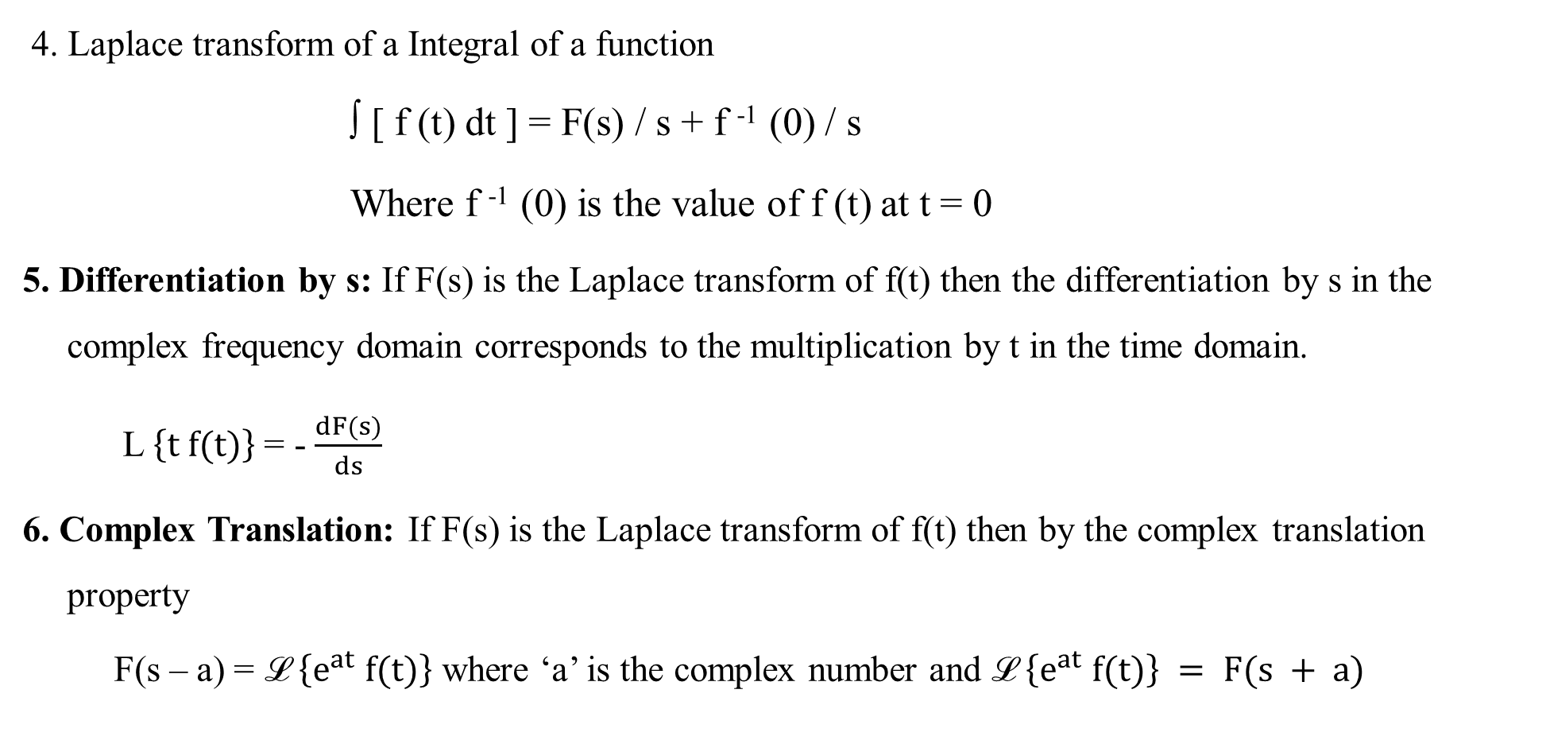
LAPLACE TRANSFORM
4. Laplace transform of a Integral of a function
∫ [ f (t) dt ] = F(s) / s + f ⁻¹ (0) / s
Where f ⁻¹ (0) is the value of f (t) at t = 0
5. Differentiation by s: If F(s) is the Laplace transform of f(t) then the differentiation by s in the complex frequency domain corresponds to the multiplication by t in the time domain.
L $\left\{t f(t)\right\}$ = - $\frac{dF(s)}{ds}$
6. Complex Translation: If F(s) is the Laplace transform of f(t) then by the complex translation property
F(s – a) = ℒ $\left\{e^{at} f(t)\right\}$ where ‘a’ is the complex number and ℒ $\left\{e^{at} f(t)\right\} = F(s + a)$

Slide 15

LAPLACE TRANSFORM
7. Real Translation (Shifting Theorem) : This theorem is useful to obtain the Laplace transform of the shifted or delayed function of time.
If F(s) is the Laplace transform of f(t) then Laplace transform of the function delayed by time T is
ℒ $\left\{f (t − T)\right\}$ = $e^{−Ts }$F(s)

Slide 16
LAPLACE TRANSFORM
S. NO. | PROPERTY | TIME DOMAIN | FREQUENCY DOMAIN
1. | Independent variable | Time t | Complex frequency s = σ + jꞶ
2. | Signal representation | Waveform f(t) | Transform F(s)
3. | Linearity property | a₁f₁ (t) + a₂f₂(t) | a₁F₁(s) + a₂F₂(s)
4. | Integration Property | ∫ f₁(t) dt | F(s) / s
5. | Differentiation Property | d / dt [f(t)] | sF(s) - f′(0₋)
 |  | d²/ dt² [f(t)] | s² F(s) –s f(0-) – s f′ (0-)
 |  | d³ / dt³ [f(t)] | s³ F(s) –s² f(0-) – s f′ (0-) – f ′′(0-)

Slide 17
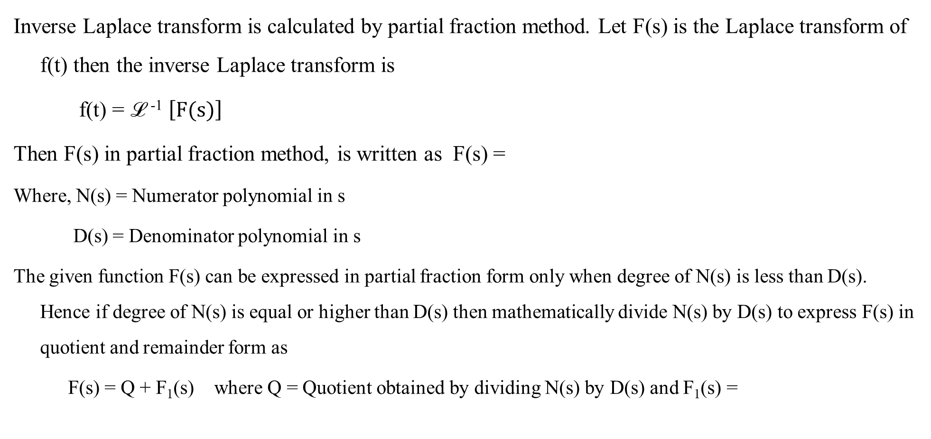
INVERSE LAPLACE TRANSFORM
Inverse Laplace transform is calculated by partial fraction method. Let F(s) is the Laplace transform of f(t) then the inverse Laplace transform is
f(t) = ℒ ⁻¹ $\left[F(s)\right]$
Then F(s) in partial fraction method, is written as F(s) =
Where, N(s) = Numerator polynomial in s
D(s) = Denominator polynomial in s
The given function F(s) can be expressed in partial fraction form only when degree of N(s) is less than D(s). Hence if degree of N(s) is equal or higher than D(s) then mathematically divide N(s) by D(s) to express F(s) in quotient and remainder form as
F(s) = Q + F₁(s) where Q = Quotient obtained by dividing N(s) by D(s) and F₁(s) =
N(s)
D(s)
N’(s)
= Remainder
D’(s)
Reference: Network Analysis & Synthesis by Uday Bakshi and Ajay Bakshi, Technical Publications Pune

Slide 18
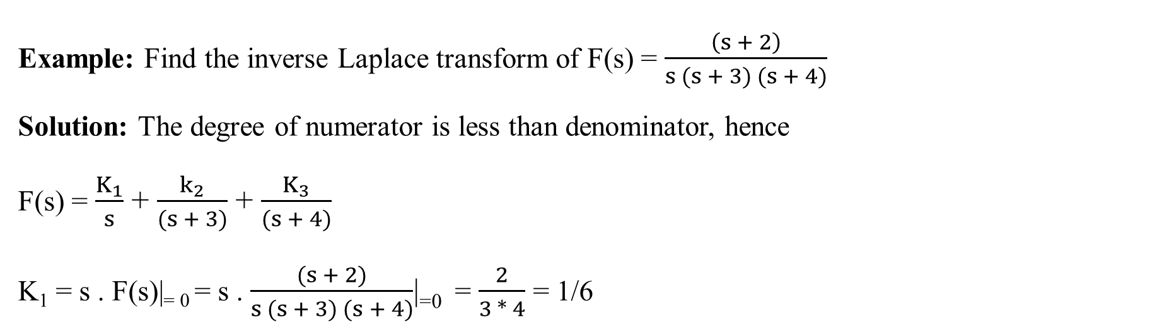
INVERSE LAPLACE TRANSFORM
Now in the remainder degree of N’(s) is less than D’(s) and hence F₁(s) can be expressed in the partial fraction form and then take inverse Laplace transform.
The roots of denominator polynomial D(s) play an important role.
Simple and Real Roots:
Example: Find the inverse Laplace transform of F(s) = $\frac{\left(s + 2\right)}{s (s + 3) (s + 4)}$
Solution: The degree of numerator is less than denominator, hence
F(s) = $\frac{K_{1}}{s}$ + $\frac{k_{2}}{(s + 3)}$ + $\frac{K_{3}}{(s + 4)}$
K₁ = s . F(s)|₌ ₀ = s . $\frac{(s + 2)}{s (s + 3) (s + 4)}$|₌₀ = $\frac{2}{3 ∗ 4}$ = 1/6
Reference: Network Analysis & Synthesis by Uday Bakshi and Ajay Bakshi, Technical Publications Pune

Slide 19
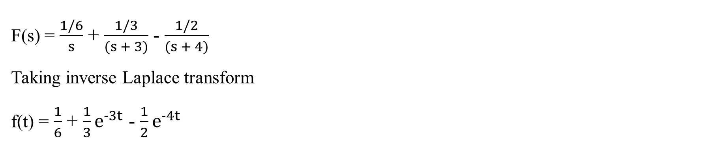
INVERSE LAPLACE TRANSFORM
K₂ = (s + 3) . F(s)|_{s = -3} = (s + 3) . $\frac{\left(s + 2\right)}{s (s + 3) (s + 4)}$
K₂ = 1/3
s = -3
K₃ = (s + 4) . F(s)|_{s = -4} = (s + 4) . $\frac{\left(s + 2\right)}{s (s + 3) (s + 4)}$
K₃ = -1/2
s = -4
F(s) = $\frac{1/6}{s}$ + $\frac{1/3}{(s + 3)}$ - $\frac{1/2}{(s + 4)}$
Taking inverse Laplace transform
f(t) = $\frac{1}{6}$ + $\frac{1}{3}e^{−3t}$ - $\frac{1}{2}e^{−4t}$
Reference: Network Analysis & Synthesis by Uday Bakshi and Ajay Bakshi, Technical Publications Pune

Slide 20
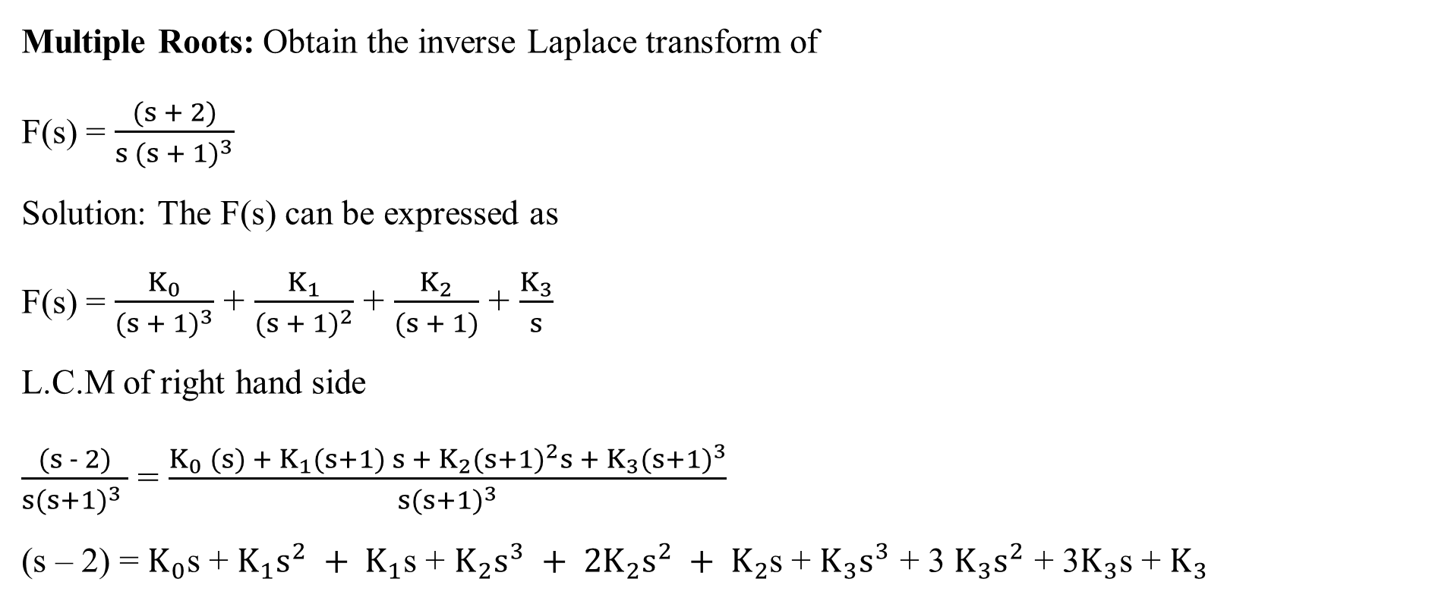
INVERSE LAPLACE TRANSFORM
Multiple Roots: Obtain the inverse Laplace transform of
F(s) = $\frac{(s + 2)}{s {(s + 1)}^{3}}$
Solution: The F(s) can be expressed as
F(s) = $\frac{K_{0}}{{(s + 1)}^{3}}$ + $\frac{K_{1}}{{(s + 1)}^{2}}$ + $\frac{K_{2}}{(s + 1)}$ + $\frac{K_{3}}{s}$
L.C.M of right hand side
$\frac{(s − 2)}{s{(s+1)}^{3} }$ = $\frac{K_{0} (s) + K_{1}(s+1) s + K_{2}{(s+1)}^{2}s + K_{3}{(s+1)}^{3}}{s{(s+1)}^{3}}$
(s – 2) = $K_{0}$s + $K_{1}s^{2} + K_{1}$s + $K_{2}s^{3} + 2K_{2}s^{2} + K_{2}$s + $K_{3}s^{3}$ + 3 $K_{3}s^{2}$ + 3$K_{3}$s + $K_{3}$
Reference: Network Analysis & Synthesis by Uday Bakshi and Ajay Bakshi, Technical Publications Pune

Slide 21

LAPLACE TRANSFORM
Comparing the coefficients of various power of s on both side
For s³, K₂ + K₃ = 0
For s², K₁ + 2K₂ + 3K₃ = 0
For s¹, K₀ + K₁ + K₂ + 3K₃ = 1
For s⁰, K₃ = -2
Solve for K
K₂ = 2, K₁ = 2 and K_{o} = 3
F(s) = $\frac{3}{{(s+1)}^{3}}$ + $\frac{2}{{(s+1)}^{2}}$ + $\frac{2}{(s+1)}$ - $\frac{2}{s}$
Now ℒ $\left[e^{−at} t^{n}\right]$ = $\frac{n!}{{(s+a)}^{n+1}}$
Reference: Network Analysis & Synthesis by Uday Bakshi and Ajay Bakshi, Technical Publications Pune

Slide 22
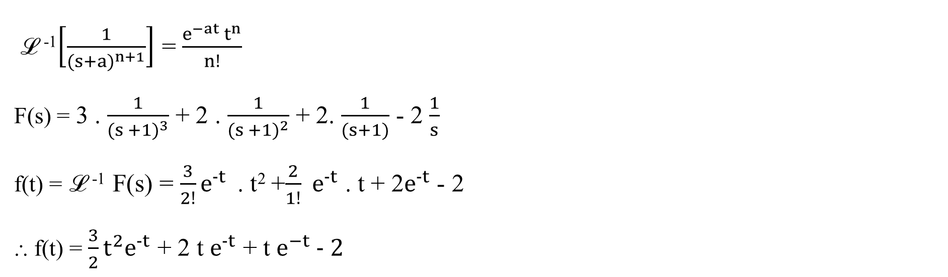
LAPLACE TRANSFORM
ℒ ⁻¹$\left[\frac{1}{{(s+a)}^{n+1}}\right]$ = $\frac{e^{−at} t^{n}}{n!}$
F(s) = 3 . $\frac{1}{{(s +1)}^{3}}$ + 2 . $\frac{1}{{(s +1)}^{2}}$ + 2. $\frac{1}{(s+1)}$ - 2 $\frac{1}{s}$
f(t) = ℒ ⁻¹ F(s) = $\frac{3}{2!}e^{−t}$ . t² +$\frac{2}{1!}$ $e^{−t}$ . t + 2$e^{−t}$ - 2
⸫ f(t) = $\frac{3}{2}t^{2}e^{−t}$ + 2 t $e^{−t}$ + t $e^{−t} − 2$
Reference: Network Analysis & Synthesis by Uday Bakshi and Ajay Bakshi, Technical Publications Pune

Slide 23
LAPLACE TRANSFORM
Reference: Network Analysis & Synthesis by Uday Bakshi and Ajay Bakshi, Technical Publications Pune

Slide 24
LAPLACE TRANSFORM
Reference: Network Analysis & Synthesis by Uday Bakshi and Ajay Bakshi, Technical Publications Pune

Slide 25
LAPLACE TRANSFORM
Reference: Network Analysis & Synthesis by Uday Bakshi and Ajay Bakshi, Technical Publications Pune

Slide 26
THANK YOU
shasansaeed@yolasite.com
hasansaeed872726549.wordpress.com

